Slide 1
minikube deep dive
Medya Ghazizadeh - Google
Rohit Anand - NEC
Notes:
what is behind the minikube emojis !

Slide 2
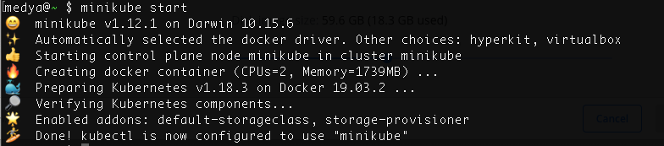
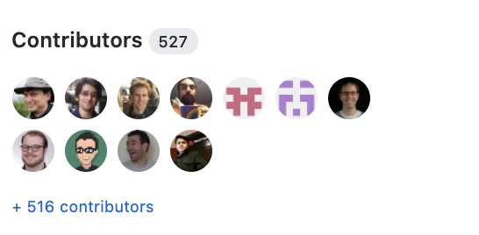
Behind the emojis
Maintainers
Thomas Strömberg
Medya Ghazizadeh
Anders Björklund
Sharif Elgamal
Priya Wadhwa
Jose Donizetti
Honourable mentions
Dan Lorenc
Govargo
Ruben Baez
Matt Rickard
Aaron Prindle
Notes:
Where I mention I work on minikube in conferneces or tech meetings, the first thing I usually hear is how much they love the emojis !
I am a witness of hard work of these names behind minikube emojis.
3.3M Github downloads
527 Contributors
97 Releases
18.8K stars

Slide 3
What is minikube
The primary goal of minikube is to make it simple to run Kubernetes locally, for day-to-day development workflows and learning purposes.
Kubernetes #sig-cluster-lifecycle project
Inclusive and community-driven (CNCF)
User-friendly
Support all Kubernetes features
Cross-platform
Reliable
High Performance
Developer Focused

Slide 4
minikube features
5 ways to build Images
fast build option using “docker-env”
Access your app:
Loadbalander & NodePort
Filesystem mounts
Feature Gates
25+ Addons
Notes:
Probably you already know about minikube features.

Slide 5
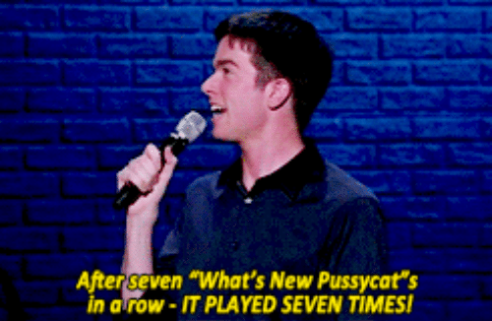
What’s New minikube ?

Slide 6
What’s new minikube ?
Starts 86% faster.
Uses 20% less CPU.
Has two new drivers (Docker,Podman)
Multi-node
New Commands: Pause/Unpause
Auto-Select flags (driver, memory, CNI …)
5 New open-source tool graduated from minikube

Slide 7
a deeper look at
What’s new minikube ...
Notes:
those are big annoucements I just made let’s take a deeper look at them
but before that, we first need to undrestand what minikube supports and who are the users of minikube

Slide 8
minikube supports ...
Green : Tested
Red : Tested but experimental
Gay : Not Tested
Hypervisor technology
Container | Docker
 | Podman
VM | Hyperkit
 | KVM
 | Hyper-V
 | Virtualbox
 | Barmetal
 | Vmware
 | Parallels
CNIs
bridge
calico
cilium
flannel
weave
kindnet
CPU Arch
amd64
arm64
ppc64
s39x
x86_64
Container Runtime
Docker
Containerd
CRI-O
OS
Linux
MacOs
Windows
Notes:
minikube has a huge user base, we have 3.3 million download on github. … and our users have different platforms and different needs.
add to this chart users from all over the world
arm64 users deploy minikube to raspberry pi

Slide 9
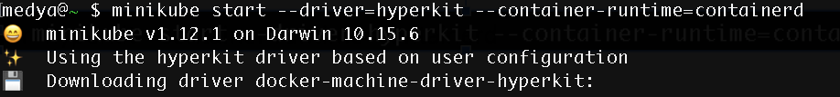
mac user example
Hypervisor technology
Container Base Image | Docker
 | Podman
VM ISO | Hyperkit
 | KVM
 | Hyper-V
 | Virtualbox
 | Barmetal
 | Vmware
 | Parallels
CNIs
bridge
calico
cilium
flannel
weave
kindnet
CPU Arch
amd64
arm64
ppc64
s39x
x86_64
Container Runtime
Docker
Containerd
CRI-O
OS
Linux
MacOs
Windows

Slide 10
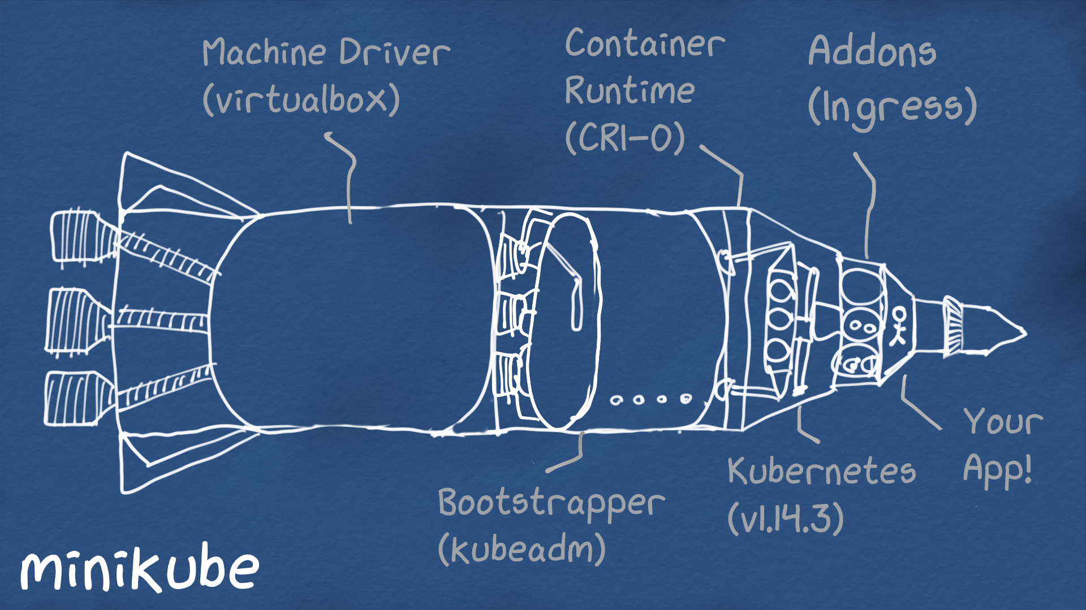

Slide 11
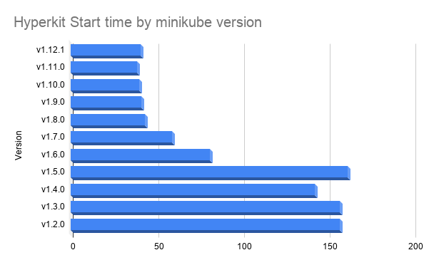
86% Faster Start
once upon a time (last year)
hyperkit driver minikube took 2m35.072s to start. same driver now takes 35s
and with the new docker driver on linux it can be a fast as 21 seconds (%86 faster)
** macbook pro 2.8 GHz Quad-Core Intel Core i7 ** does not include the first time download images time

Slide 12
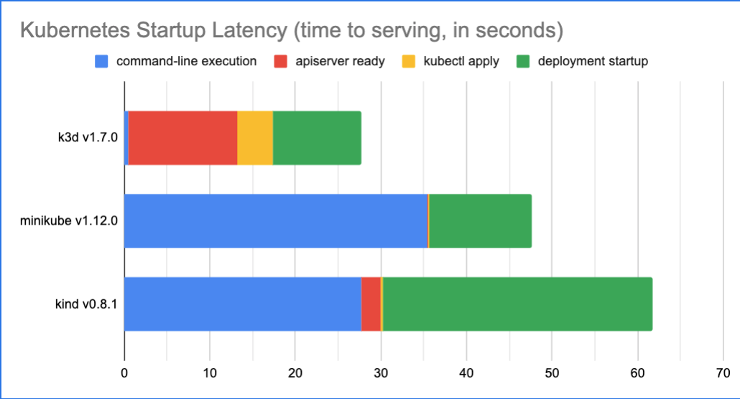
The Actual time cluster is usable
Data was aggregated across 113 runs using automated tools.
k3d forks the kubernetes code, to replace etcd.
Scripts that was used to generate data is available at https://github.com/tstromberg/time-to-k8s
Notes:
Another way to measure is, when a cluster is Actually usable by the user.
this shows comparison between k3d and minikube and kind. as you see for kind cluster to be usable u need to wait more than 60 seconds.
You might have seen time sleeps in the scripts that use kind.
minikube verifies and waits for a few components to be ready before exiting. (can be overridied by --wait=false or you can make minikube wait for all of the components by specifying --wait=all)

Slide 13
How did minikube go from
2m35s minute to 21 seconds ?
Notes:
Most reacted issue in minikube

Slide 14
Step 1: Collect metrics
Notes:
but first coffee? … no yes…

Slide 15
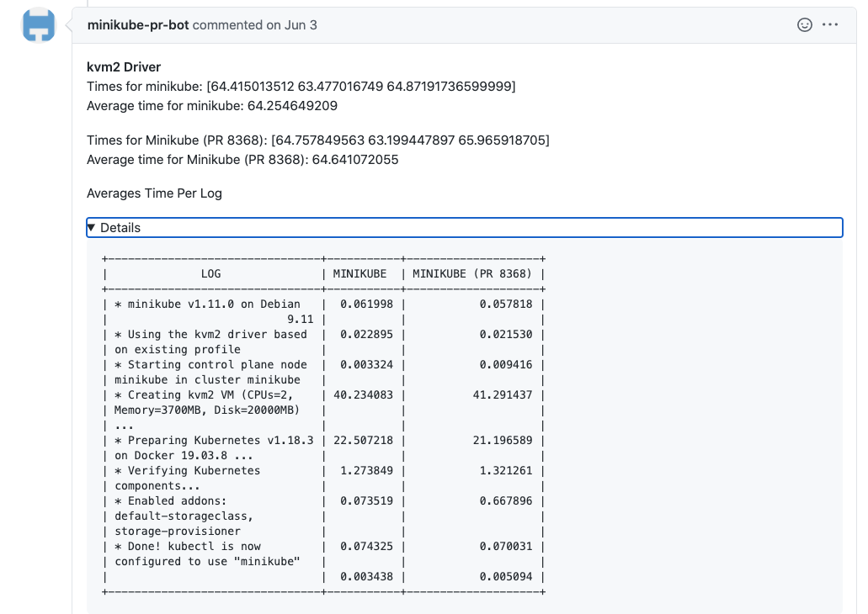
Performance Bot PR commet
Github bot to analyze PR’s performance difference.
by Priya Wadhwa
Notes:
we wanted to know how much a PR would affect the performance.
we certainly didn’t wanna accept a PR that made minikube slower ! but also we didnt wanna merge a PR that claimed makes minikbue faster but added too much complexity or technical debt.
we had PRs that did some crazy hard to maintain parallelization that we thought it would make minikube faster but the performance bot proved it didnt !

Slide 16
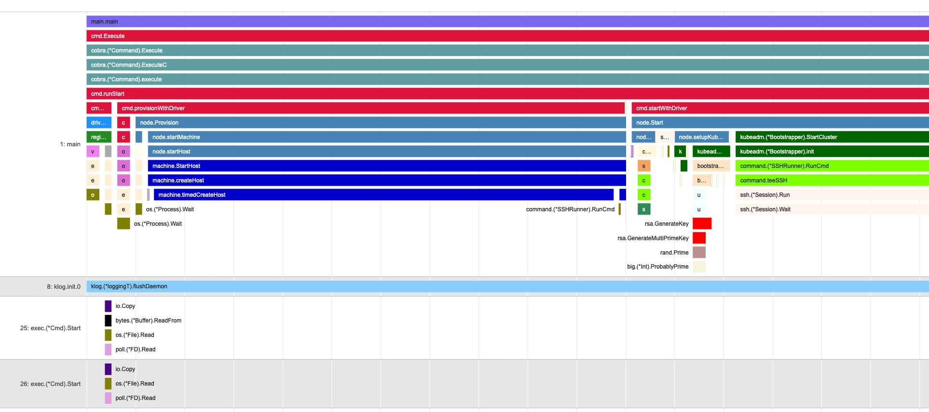
Slowjam: Visualize stack trace
Slowjam by Thomas Stromberg
Notes:
with slowjam we could see exactly which function in the stack trace is taking longer.
this was another part of collecting metrics and analyzing
remebeber we are talking about minikube taking 2.5 minutes to start and wanna make under it 30 seconds.

Slide 17
Big Targets for optimization
Creating VM
Loading kubernetes Images
s
Notes:
these are two big ones, and also tons of other small thing that all added up to significant numbers.

Slide 18
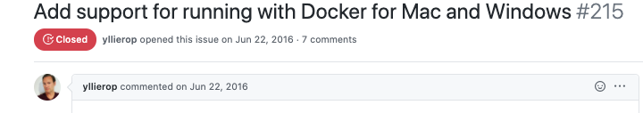
VM-Free Request 2016
one of the oldest feature requests of minikube (June, 2016)
Notes:
most obvious was instead of creating a VM, create something more light-weight.

Slide 19

VM-Free Design
Question
in minikube we create a VM and setup kubernetes inside.
why can’t we just create a container and do exact same thing ?
Notes:
when I joined minikube team as my second big task I picked up delivering VM-Free minikube. and I spend time studying why someone has not already done it ? why there is a project called kind and it is not a driver of minikube?
so the answer is, when we tried to do that the container exits.
I spent a lot of time studying kind’s code to see what that we are not, and I couldn’t find anything we were not doing or anything I could reusse. infact minikube was already dong all of those things plus more…
for more features like more container-runtimes, more features such as docker-env, loadbalancer, service , corp certs, ….
and quite frannkly I was discourged by some pople, that it is not possible to do this in minikube
but I am a presistant kurdish guy ! I dont give up !
so I found out the reason that container exists, is systemd can run in a container normally !

Slide 20
VM-Free Design
New Question
How to run Systemd in a container ?
Answer in Redhat blog
Notes:
So now the question becomes simpler ! and there was a tech
Kind has solved this by adding an entrypioint to their ubuntu image !

Slide 21
and it worked !
Question ! can we have all minikube features ?
Yes. Some with more work.
Notes:
The answer was, in expremenal version
so we released an experiment docker driver on Christams.

Slide 22
It’s called Kic for a reason !
If we could add Docker driver, what stopped us from adding Podman ?

Slide 23
Docker on Mac/Windows
Docker Desktop (on mac and windows) does not give you an accessible IP address for the container
That made These features challenging:
Tunnell
Service
Jose Donizetti’s implemented a solution for docker network limitations.
Notes:
and thats how minikube docker driver became GA !

Slide 24

KIC and other refactors made minikube more than 1 minute faster but still we had a long way to go …to become under 35 seconds.
Next Target is preloading images
Notes:
New analyze using slowjam and performance bot showed we need to make invest in preloading the images.
for example in kind they backe the image with the kubernetes images loaded into them, and for each version of you need an image.
but minikube had a different model. remember we had to support all other drivers and not make minikube code Special just for docker driver.

Slide 25

New question:
can we preload the images for both VM drivers and Container drivers (docker,podman) same way ?

Slide 26
Preload Images
Pull kubernetes images into the container-runtime
Freeze the file-system and lz4 zip them (for smallest size)
Upon container creation, spin up a side-container and unzip in Parallel and by the time the main container is running.
Save time by doing this in parallel and load the volume to the main container.
For details on generating the preload images checkout:
github.com/kubernetes/minikube/tree/master/hack/preload-images
Notes:
Design 1 Allowed us :
use the same approach for both VM and ISO
making base images smaller and more reusable.

Slide 27
In addition to VM-Free and Preload, we did tons of other small optimizations in kubernetes that made minikube start %86 faster

Slide 28
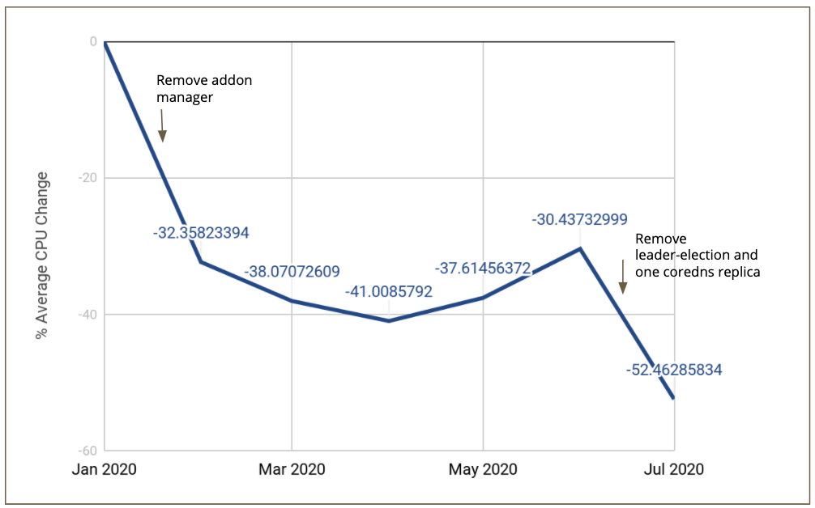
minikube cpu overhead in 2020
Screenshot from related talk: Improving the Performance of Your Kubernetes Cluster
by Priya Wadhwa, Google
Tuesday, August 18 • 18:30 - 19:05

Slide 29
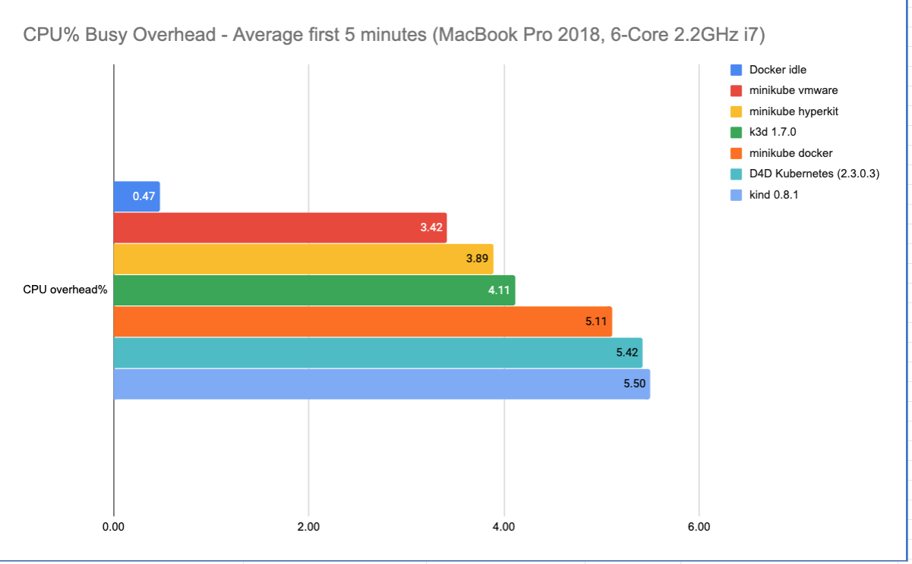
minikube vs others
Lower is better

Slide 30
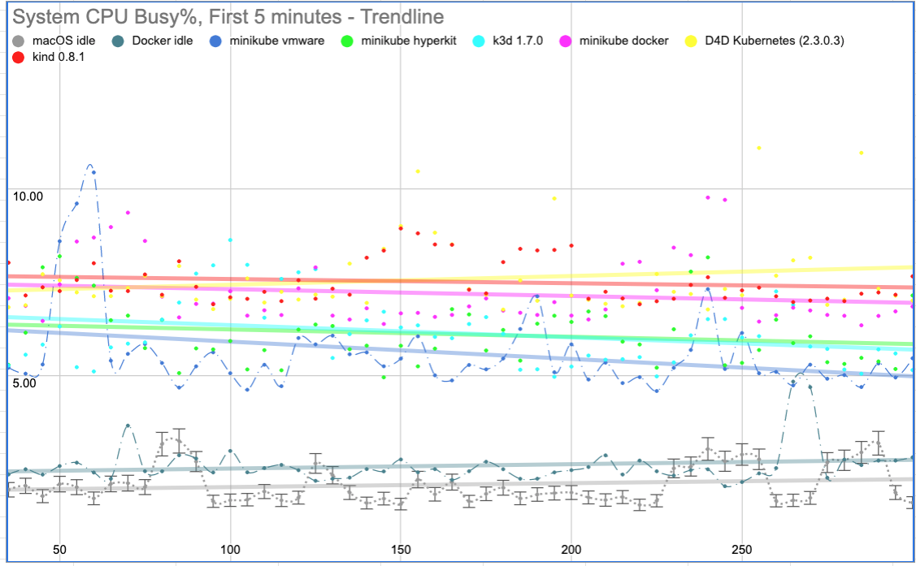
minikube vs others

Slide 31
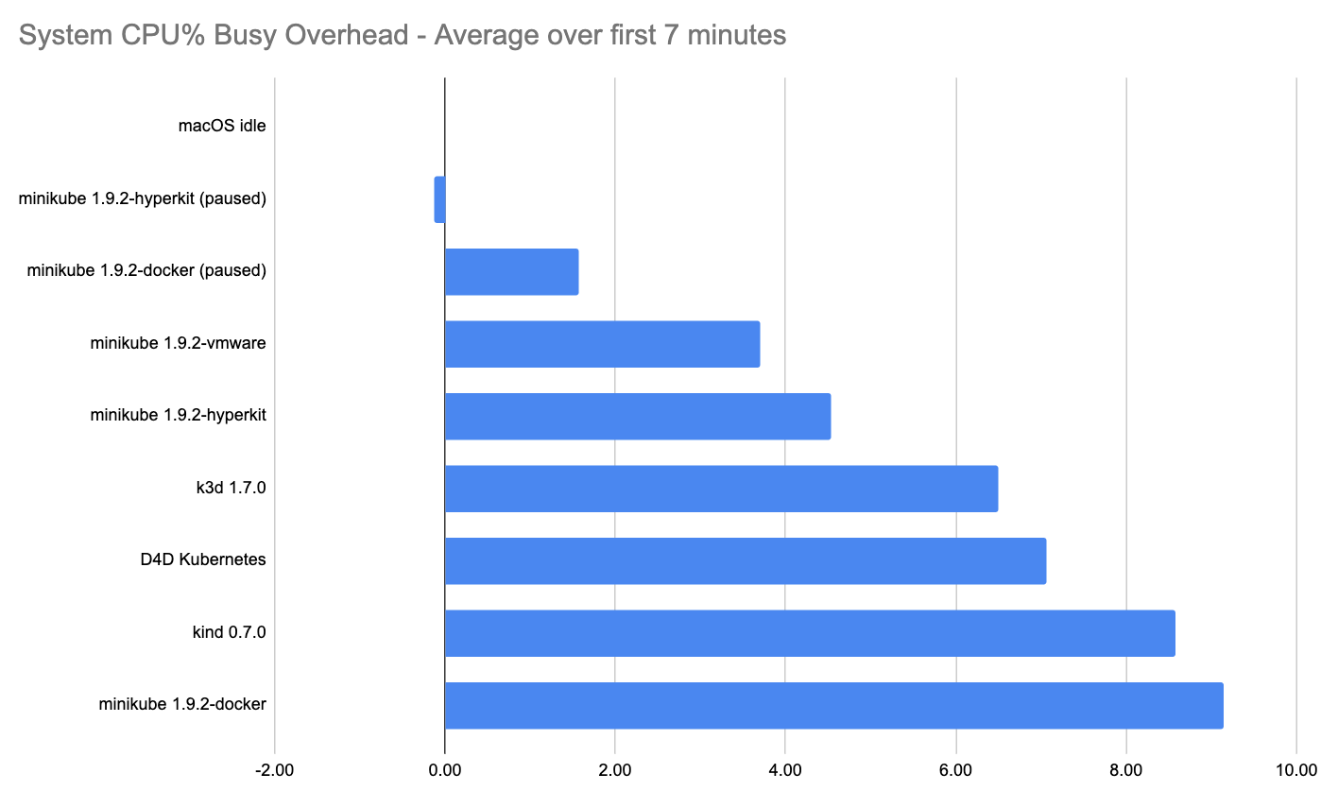
Pause Kubernetes, Continue App
Try pause command today !
$ minikube pause
$ minikube unpause
Kubernete’s apiserver is the main cause high CPU of local kubernetes experience
“minkube pause” will pause kubernetes
a paused minikube CPU load is close to zero !
during a pased minikube your deployed app continues to be running and accessible !
minikube service and tunnell command works fine even on a paused kuberntes

Slide 32
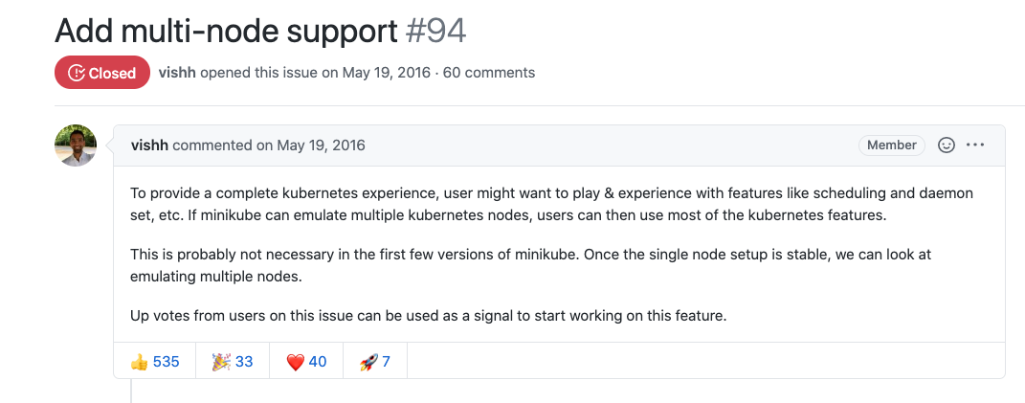
Multi-node ready to use !
Notes:
Most reacted issue in minikube

Slide 33
Auto-select options
minikube has many many flags and options to set, which is great for advanced users.
“minikube start” should do the right thing without any flags.

Slide 34
Auto-select options
Auto-select driver
checks your system for all available options and picks best driver based on their health.
Auto-select memory-size:
picks the best memory size for your cluster based on how much ram you have.
Auto-Select CNI networks
based on on if you selected options (single or multinode,...)

Slide 35
Addon - Auto Auth GCP
minikube addons enable gcp-auth

Slide 36
Demo Time
How to add a new language to minikube ?

Slide 37
How do you we not break things when supporting so many different platforms/drivers/options ?
Each time we break a thing, we write an integration test for it

Slide 38
remember this slide ?
Green : Tested
Red : Tested but experimental
Gay : Not Tested
Hypervisor technology
Container | Docker
 | Podman
VM | Hyperkit
 | KVM
 | Hyper-V
 | Virtualbox
 | Barmetal
 | Vmware
 | Parallels
CNIs
bridge
calico
cilium
flannel
weave
kindnet
CPU Arch
amd64
arm64
ppc64
s39x
x86_64
Container Runtime
Docker
Containerd
CRI-O
OS
Linux
MacOs
Windows
Notes:
minikube has a huge user base, we have 3.3 million download on github. … and our users have different platforms and different needs.
add to this chart users from all over the world
arm64 users deploy minikube to raspberry pi

Slide 39
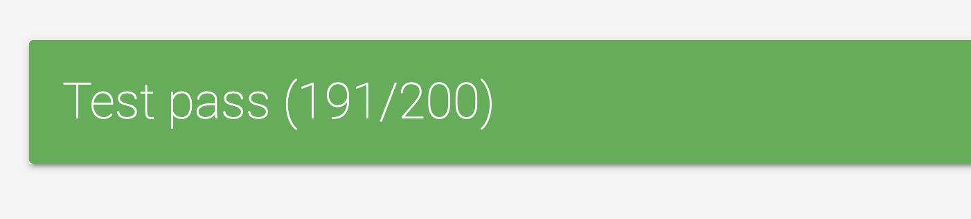
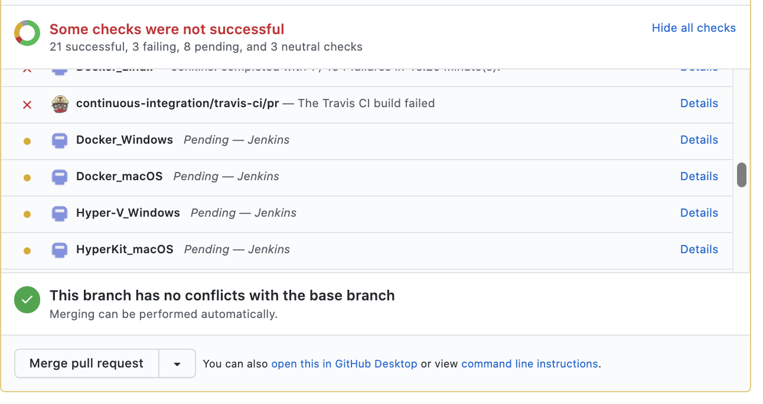

Slide 40
Gopogh
When we do so much testing and have so much log ! we need a tool to help us read the integration logs
Gopogh converts golang test logs to HTML.
See Before , After
Github repo: github.com/medyagh/gopogh

Slide 41
Testing minikube
Unit Test
Integration Test
200 integration tests
Conformance Test
ISO / Base Image Test
Stress Test
Notes:
We test all kind of things in our integration tests, like we test all functionalities, Airplane Mode, Proxy Environment, Corp Environment, Tessting Upgrading minikube, ...all kind of things.

Slide 42
Testing Infra
Google Cloud
Microsoft Azure
Jenkins
Github actions

Slide 43
minikube flags for ci
minikube --wait=all --delete-on-failure --interactive false

Slide 44
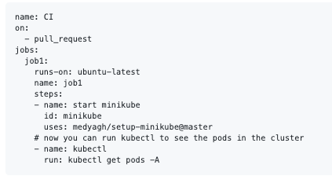
setup-minikube github action
Full Example Here https://github.com/marketplace/actions/setup-minikube

Slide 45
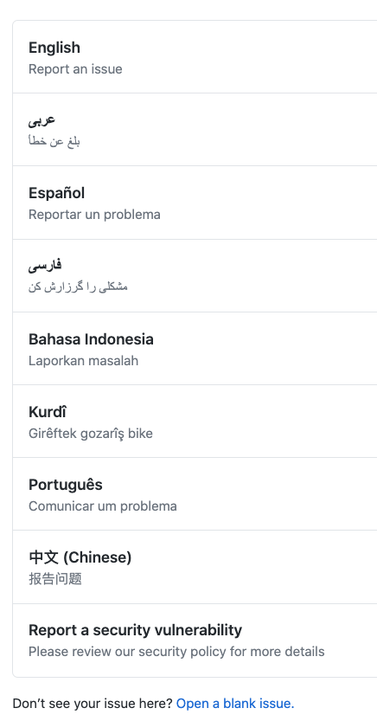
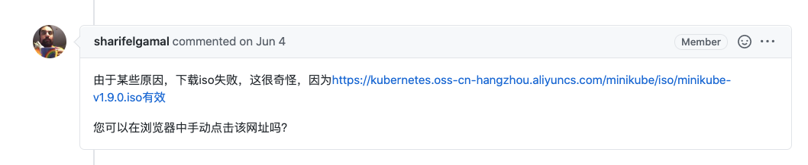
minikube speaks yours language
minikube speaks french:
LC_ALL=fr out/minikube start
😄 minikube v1.9.2 sur Darwin 10.14.5
✨ Choix automatique du driver hyperkit. Autres choix: docker
👍 Démarrage du noeud de plan de contrôle minikube dans le cluster minikube
🔥 Création de VM hyperkit (CPUs=2, Mémoire=4000MB, Disque=20000MB)...
🐳 Préparation de Kubernetes v1.18.0 sur Docker 19.03.8...
🌟 Installation des addons: default-storageclass, storage-provisioner
🏄 Terminé ! kubectl est maintenant configuré pour utiliser "minikube".
Notes:
issue templates in multiple language
minikube UI lanuage
rohit will demo how to add translations to minikube

Slide 46
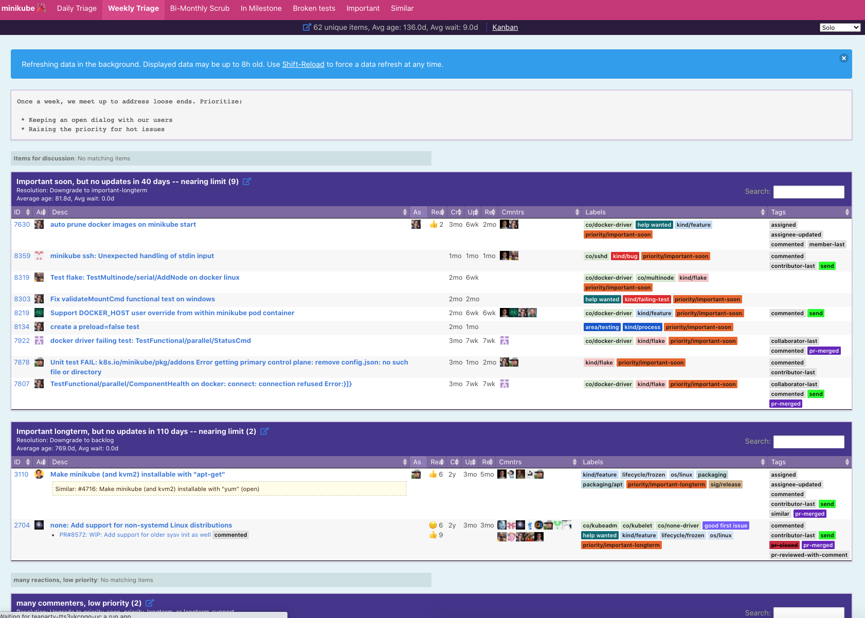
Triage Party Multiplayer-Game
Every Wednesday we have a Triage Party ! Come play Read more: https://minikube.sigs.k8s.io/docs/contrib/triage/

Slide 47
Links
Tools
setup-minikube github action github.com/marketplace/actions/setup-minikube
slowjam https://github.com/google/slowjam
triage party https://github.com/google/triage-party
gopogh https://github.com/medyagh/gopogh
gcp-webhook https://github.com/GoogleContainerTools/gcp-auth-webhook
Slack
https://kubernetes.slack.com/messages/C1F5CT6Q1

Slide 48
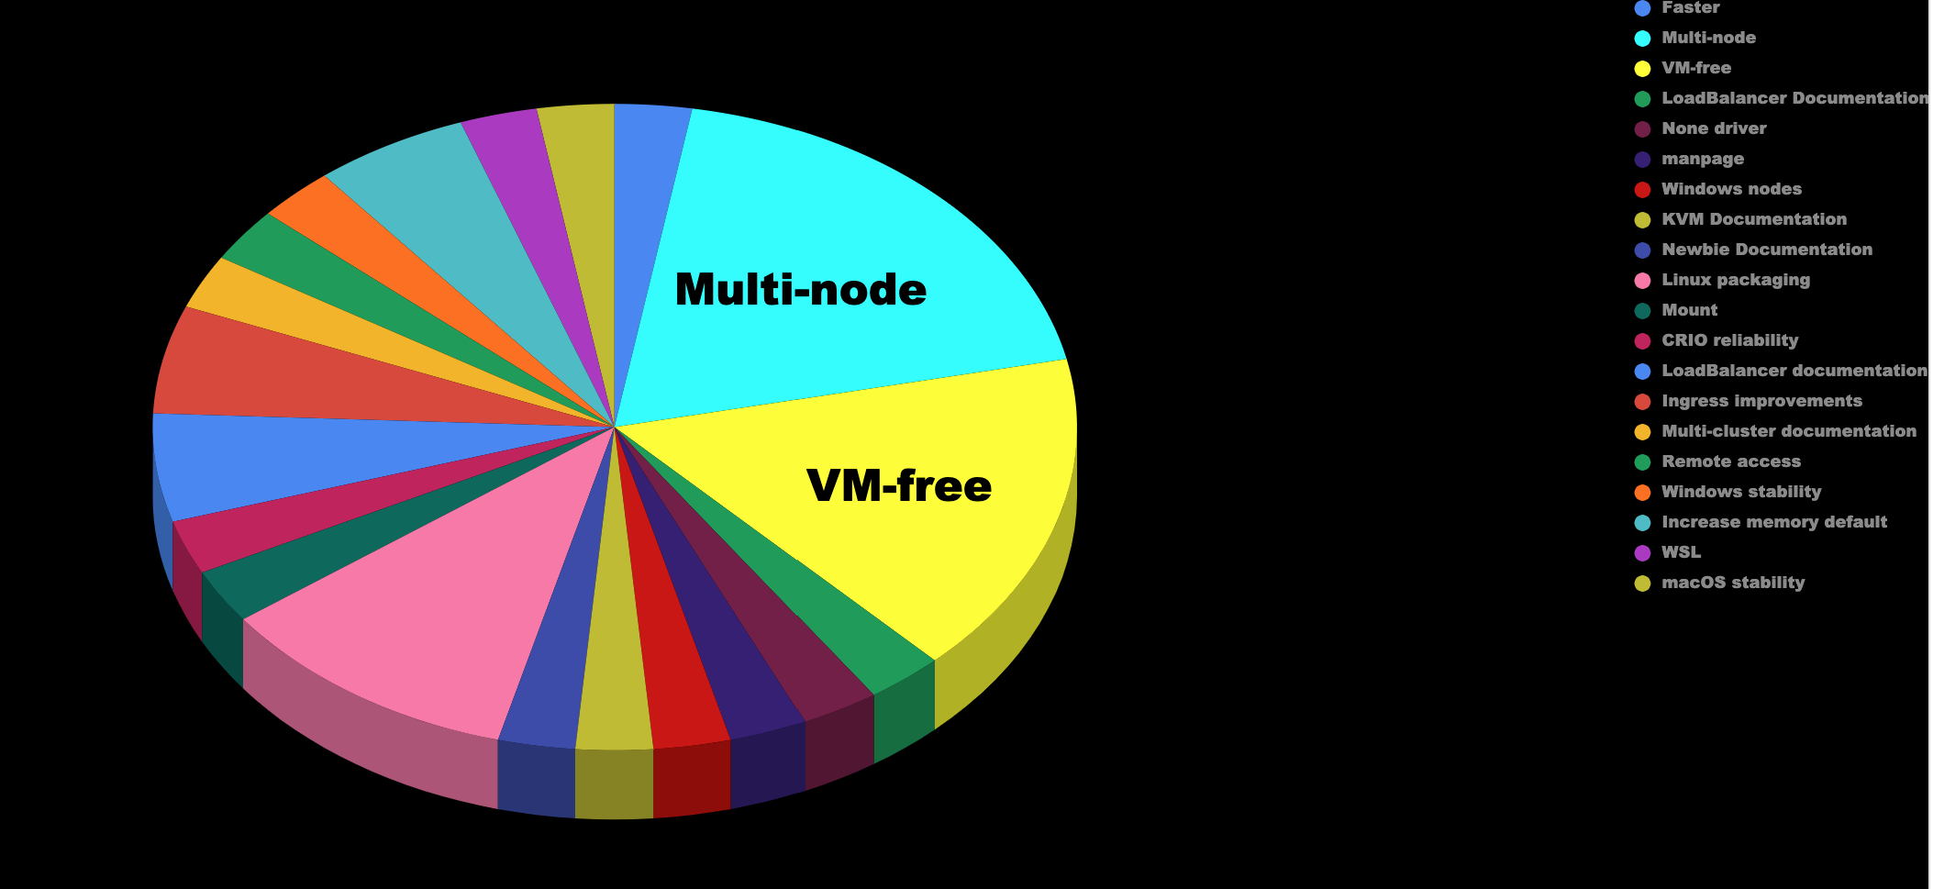
Surveys: Listened and Done !
2020 Q1 Survey 1500 responses and counting ...
Notes:
we listened to Q1 Survives, request for improving multi-node and vm-free was top requests from the 2020 Q1 survey.
that Q2 Survey we were successful to deliver the Q1 requests.

Slide 49
What is coming next?
gui
scheduled stop and start
auto-pause
chromebook support
for full list see public road map https://minikube.sigs.k8s.io/docs/contrib/roadmap/

Slide 50
minikube website
New, Simplified, Searchable
https://minikube.sigs.k8s.io
Notes:
Most reacted issue in minikube

